Slide 1
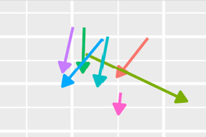

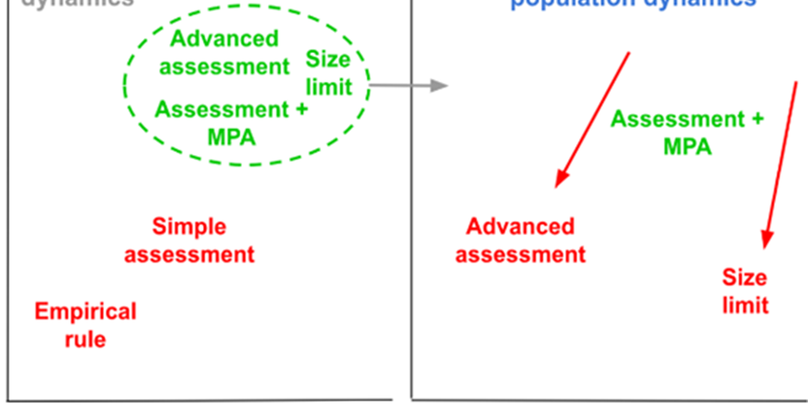


Developing the Climate Test: Robustness Trials for Climate-Ready Management Procedures
SCRS/2024/104
Tom Carruthers
3rd June 2024, ICCAT WGSAM

Slide 2
Contents
The Problem
MSE and Robustness Testing
Methods
Results
Conclusions & Discussion

Slide 3
1. The Problem
Marine communities are expected to experience increased impacts from factors relating to climate change.
There is a need for fishery management practices that are robust to changing environmental conditions, population and fishery dynamics.
Forecasting of quantitative impacts is highly uncertain and the relative credibility of scenarios is unknown. Forecasts are the product of various theoretical models, for which empirical support varies:
If scientific uncertainty over climate impacts on fish populations is inevitably very high, should this necessarily obstruct progress in establishing robust fishery management practices?
Behavior physiology biology
Fishery exploitation
Emissions
Climatology
Oceanography
Habitat
Ecology

Slide 4
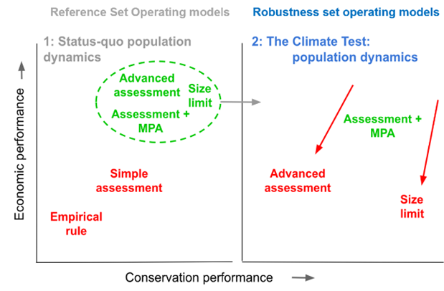
2. MSE and Robustness Testing
A framework for providing tactical advice that has been demonstrated for robustness to hypothetical scenarios.
Consider an example > where three management procedures perform similarly under the reference set of operating models.
Why not choose an MP that is also robust to the climate test if it perform comparably under the reference set of operating models?
Does it matter if the robustness tests are not well supported empirically?
Reference Set Operating Models
Climate Test Operating Models

Slide 5
3. Methods: Operating Models
6 operating models of the EcoTest framework based on SS3 stock assessment:
bigeye tuna, swordfish, blue marlin, white marlin, blue shark and shortfin mako shark.
4 climate tests and 2 levels for each based on ‘expert judgement’:
Operating model dynamics | Scenario | Moderate | Extreme
Somatic growth | von Bertalanffy growth rate K Declines (Dell’Apa et al. 2023) | -20% ‘K_Mod’ | -40% ‘K_Ext’
Mean recruitment strength (juvenile survival, carrying capacity) | Mean recruitment Declines | -25% ‘Rec_Mod’ | -50% ‘Rec_Ext’
Survival (juvenile and adult). | Instantaneous natural mortality rate M Increases | 25% ‘M_Mod’ | 50% ‘M_Ext’
Condition factor | Weight-at-length Declines | -10% ‘CF_Mod’ | -20% ‘CF_Ext’
Reference run | No change in operating model dynamics. | ‘Ref’
Percentages represent the total linear change over 30 projected years

Slide 6
3. Methods: Management Procedures
Code | Description
SzMat | Size Limit at Maturity
ITC | Index Target Catch: an MP that makes incremental (up to 10%) changes to TAC to reach an index level at SSBMSY.
ITE | Index Target Effort: as ITC but makes incremental changes to the total allowable effort (TAE).
IRC | Index Ratio Catch: an MP that aims to fish at a constant (UMSY) rate of fishing. TAC changes are up to a 10%.
IRE | Index Ratio Effort: as IRC but adjusting TAE.
SP_MSY | Surplus production – MSY: A state-space surplus production stock assessment model is fitted to simulated catch and index data and provides TAC advice that is current estimated vulnerable biomass multiplied by estimated UMSY.
SP_4010 | Surplus production – 40:10 harvest control rule: As SP_MSY but includes a ‘40:10’ harvest control rule
SpC | Spatial closure: effort is restricted for half of the available habitat. When index levels are above SSBMSY levels all habitat is open to fishing. As index levels decline below SSBMSY levels, there is a linear decline in access to half of the habitat.

Slide 7
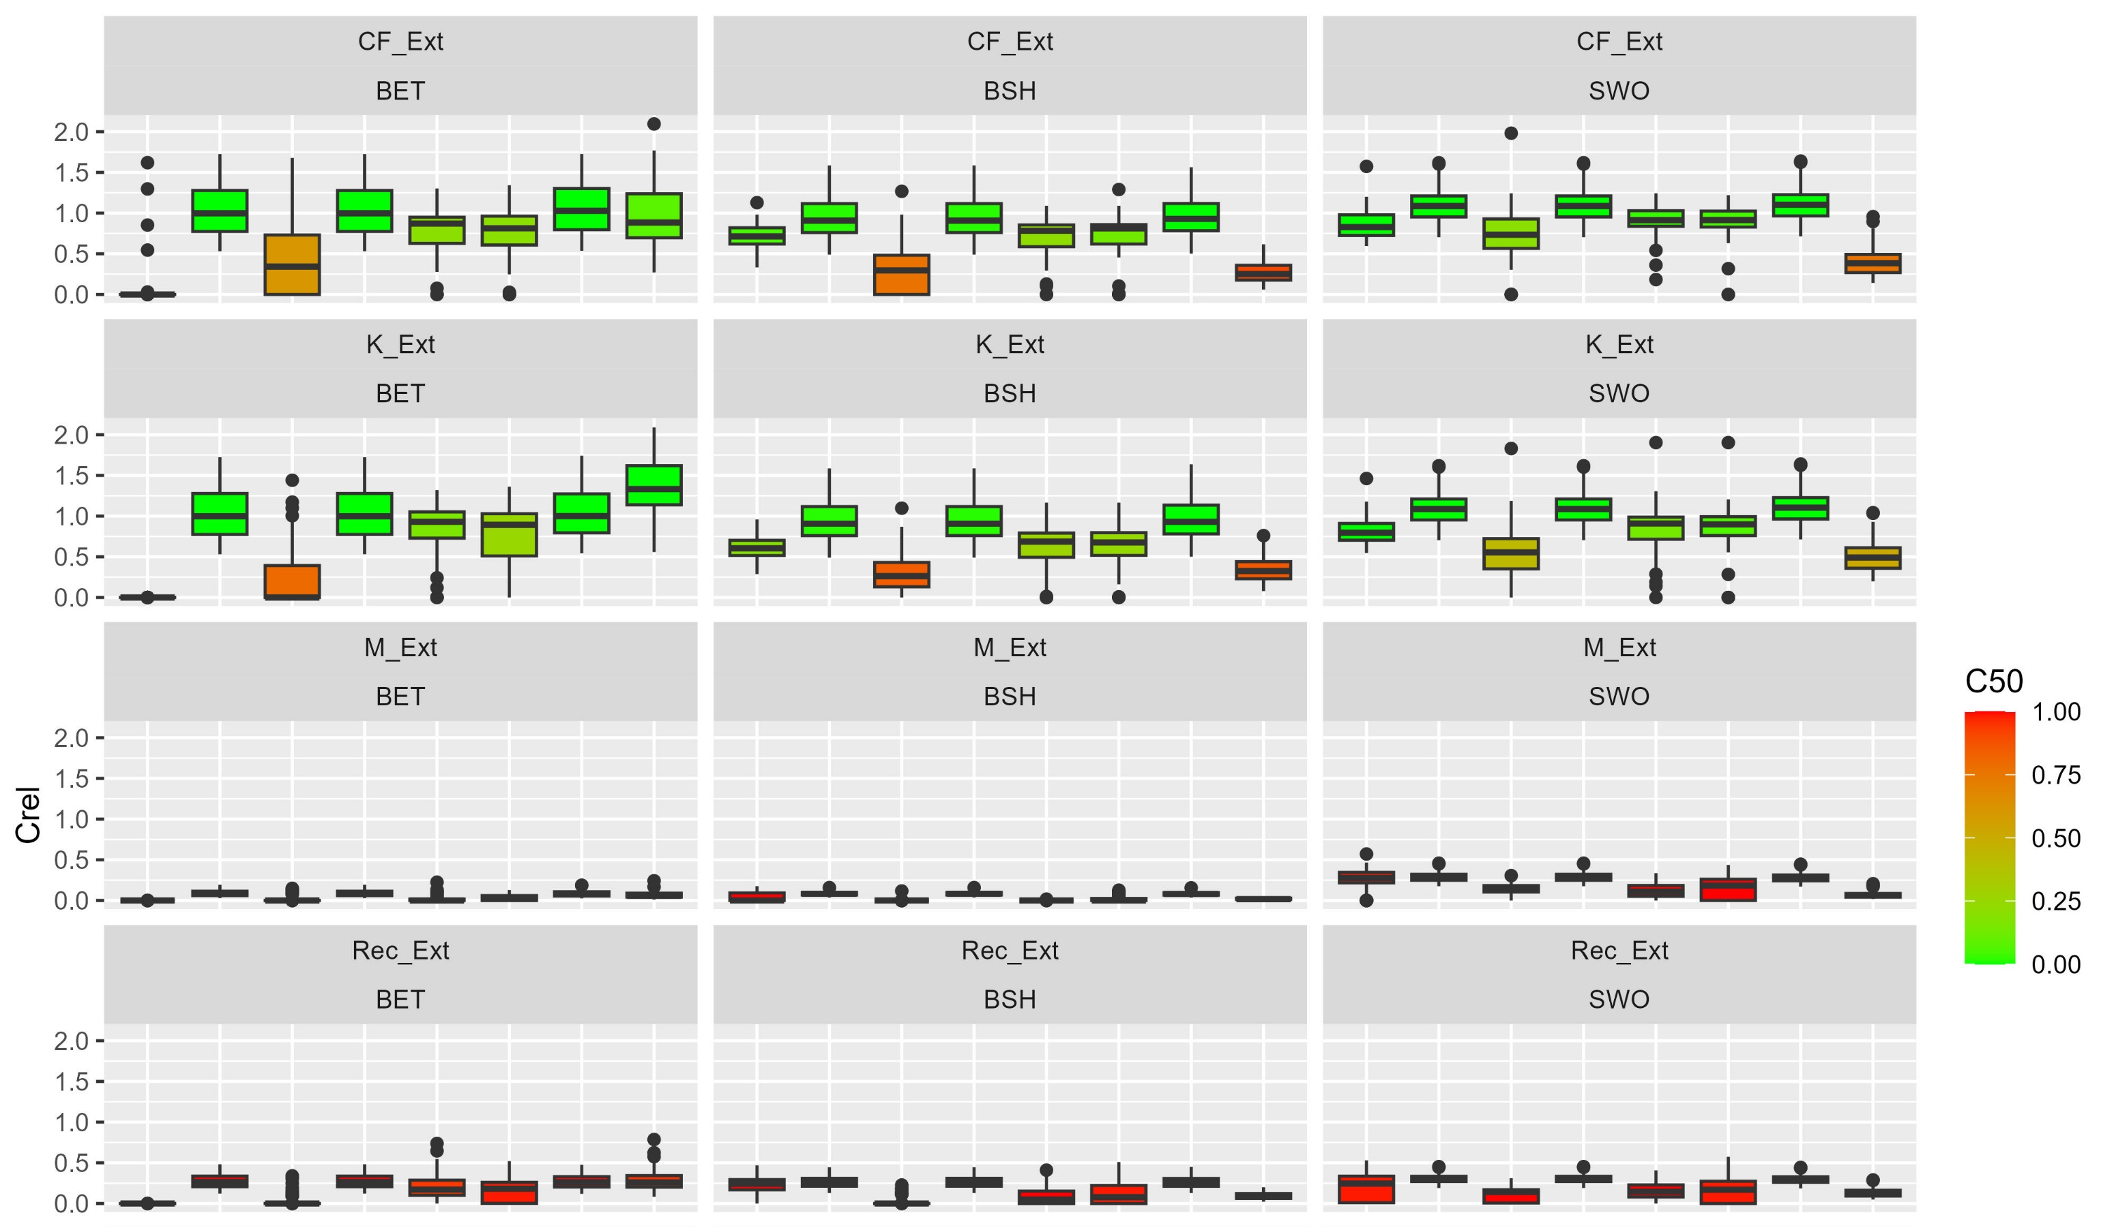

4. Results
Catch (projection year 50) / last historical year

Slide 8
4. Results
Tests with 50% declines in survival (M) and mean recruitment (Rec) were substantially tougher tests than declining condition factor (CF) and somatic growth rate (K)
Catch (projection year 50) / last historical year

Slide 9
4. Results
Index based MPs setting TAC advice (‘ITC’) amongst the least robust
Catch (projection year 50) / last historical year

Slide 10
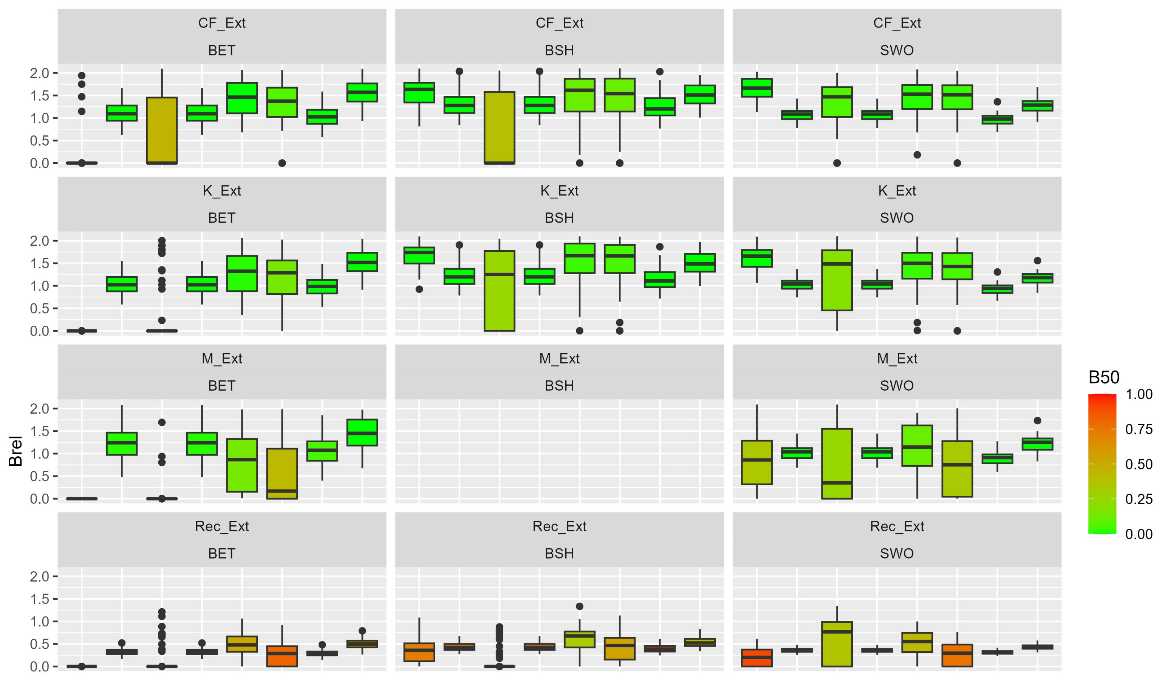
4. Results
In general, biomass outcomes less variable than yield outcomes
HCR benefits:
SP_4010 vs SP_MSY
SSB (projection year 50) / equilibrium SSBMSY

Slide 11
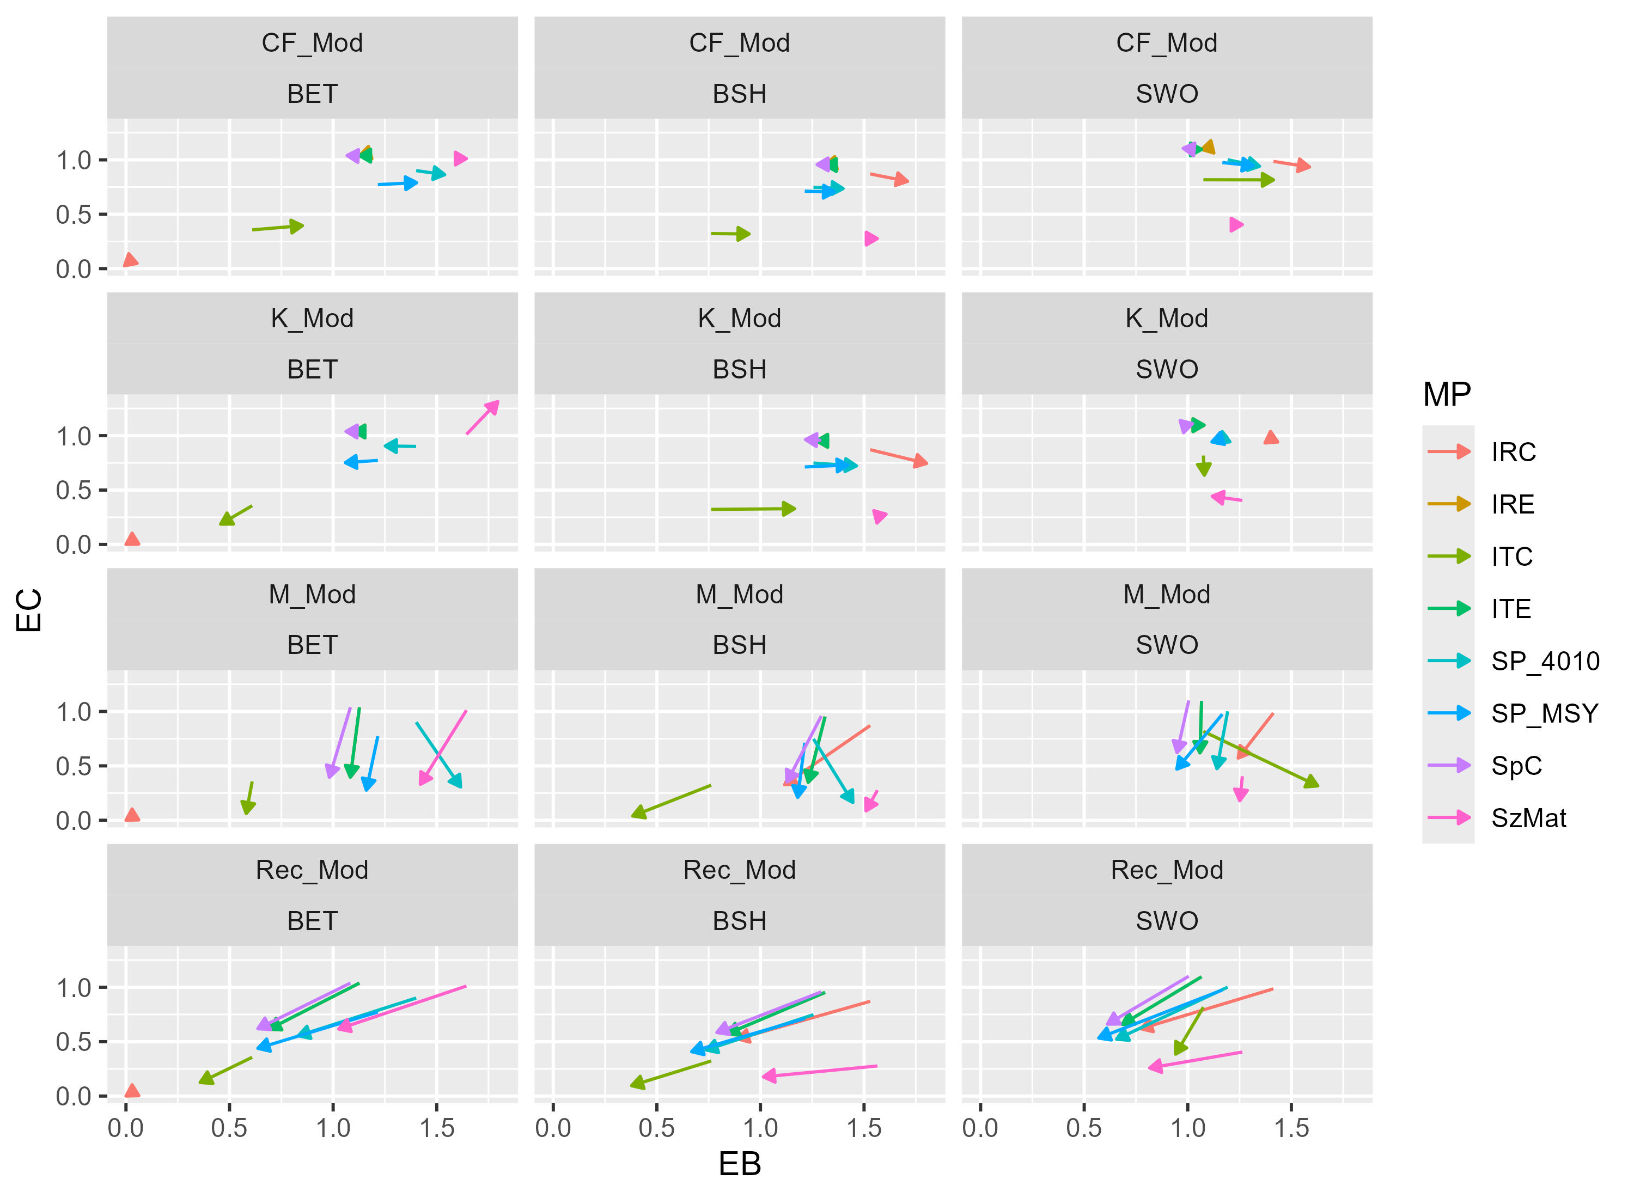
4. Results
Direction of change in performance due to climate tests was variable.
Mean Catch (projection year 50) / last historical catch
Mean Biomass (projection year 50) / SSBMSY

Slide 12
4. Results
Survival and recruitment scenarios were the most challenging
Recruitment scenarios led to large impacts on yield AND biomass outcomes
Index-based TAC MPs were amongst the least robust
Input-control MPs (TAE, size limits) generally performed better for the most challenging robustness tests.
To varying degrees, all MPs showed responsiveness, affecting yield outcomes to a greater extent than biomass outcomes
Harvest control rules provided superior biomass performance for some climate tests.

Slide 13
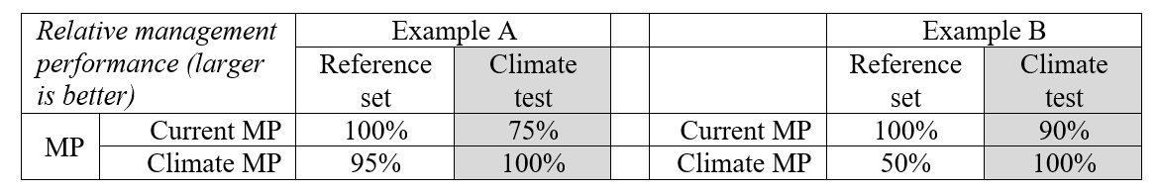
5. Conclusion & Discussion
Should we wait for scientifically defensible forecasts for individual taxon and location before developing climate-robust management advice?
MSE provides a framework for including hypothetical scenarios in tactical advice.
Start generic: add more bespoke tests as informative data / models become available
Covarying dynamics could reduce the number of tests.
Historical perspectives could constrain relative climate impacts (growth, survival, recruitment changes).
Important to show asymmetry in performance of ‘climate – specific’ MPs:

Slide 14
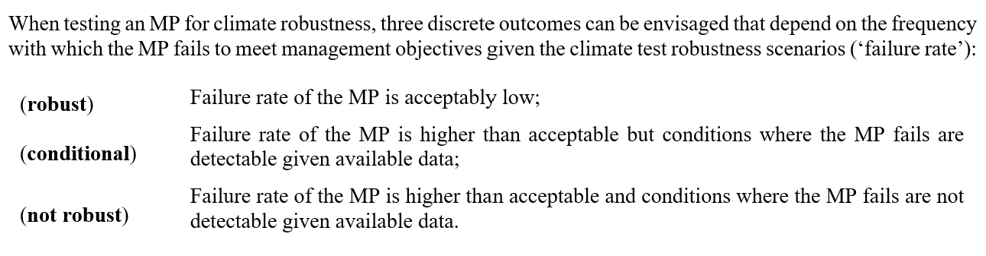
5. Conclusion & Discussion cont.
Three outcomes of such robustness testing:
A lack of robustness may be acceptable with indicators of problematic simulation conditions (exceptional circumstances)

Slide 15

Acknowledgements
This research was funded by
Thanks to
Adrian Hordyk
Quang Huynh
Shana Miller
and
Grantly Galland
for their comments on an earlier version of the Climate Test.

